Slide 1
HOW TO USE THIS TEMPLATE
?
Follow the instructions on each slide to create your presentation.
Remember a PowerPoint is a visual for your presentation. The words on each slide should serve only as talking points (rather than everything you are going to say).
Images and graphics add interest; be sure to add them to your slides when appropriate.
Choose Transitions and Animations carefully. (You want your audience to focus on your content, rather than your effects.)

Slide 2

Famous event in history (Title of the event)
One sentence summarizing the event, or a famous quote about the event.

Slide 3
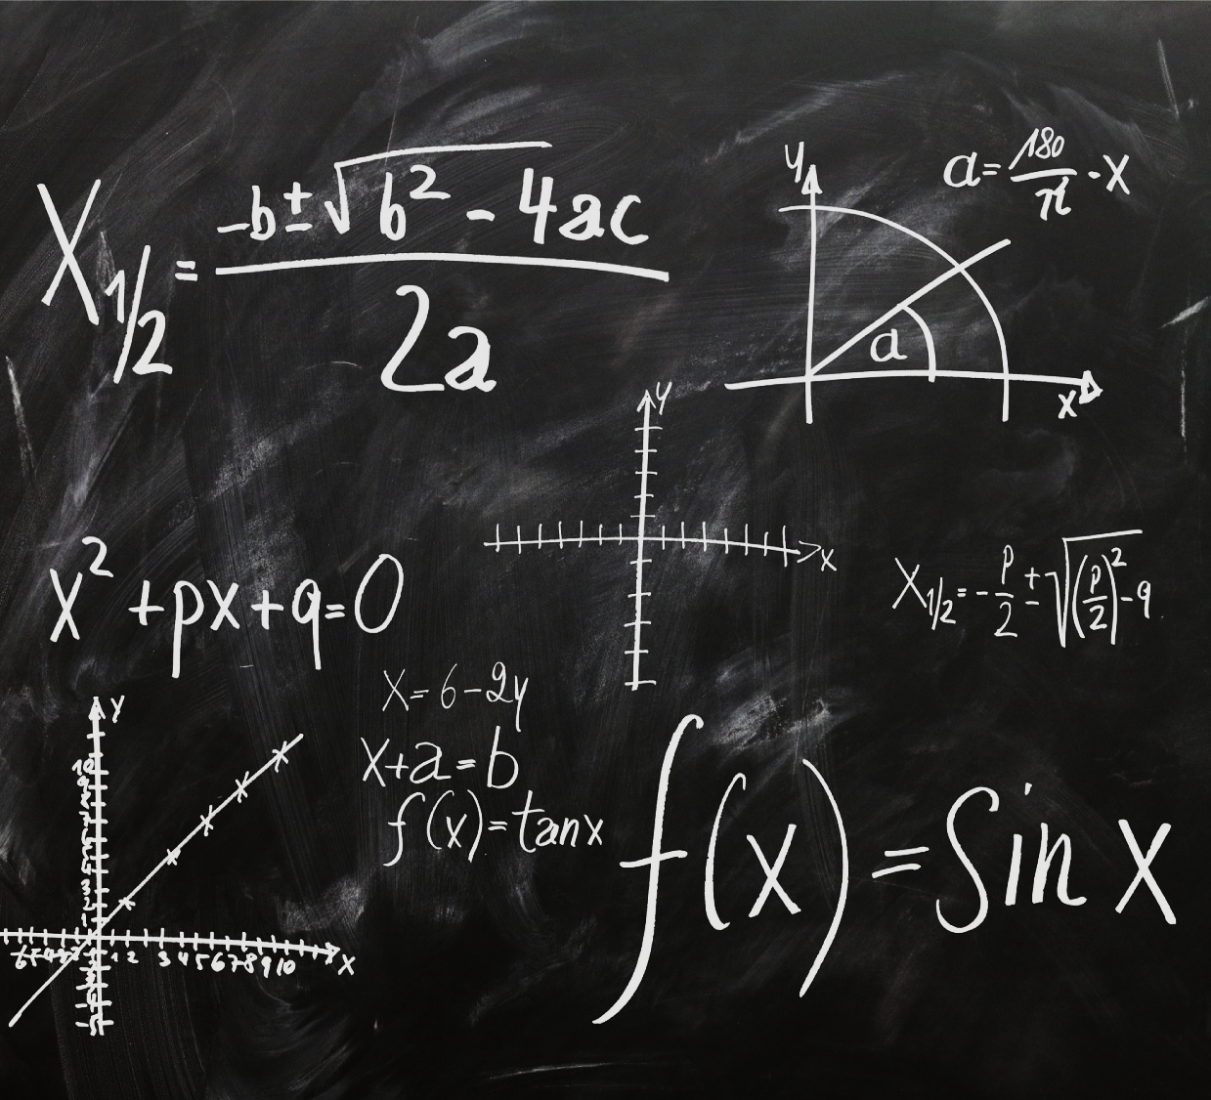

Title for the picture
Include your thesis or major claim regarding the event in history you are discussing.
Find a picture that captures the historical event you are discussing and provides a visual for your audience.

Slide 4
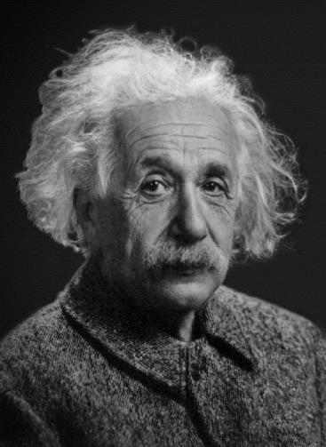
Name of important person for the historical event
Explain this person’s role or involvement in the event.

Slide 5

Title for the photo goes here
Insert photo (in the box to the right) supporting your thesis or claim sentence.
Explain how this photo supports your thesis or claim sentence.

Slide 6
FAMOUS QUOTE FROM THE EVENT, OR A GENERAL QUOTE SUPPORTING YOUR THESIS OR CLAIM SENTENCE.
Author / Writer
Evidence supporting this quote or an explanation as to why this quote is important.

Slide 7

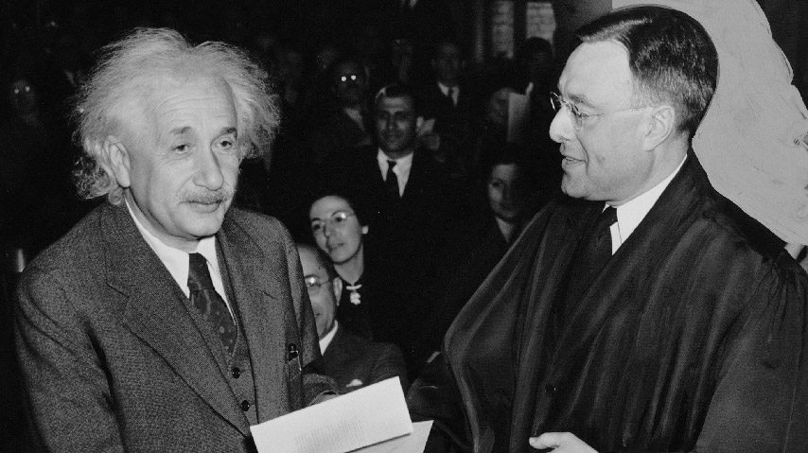
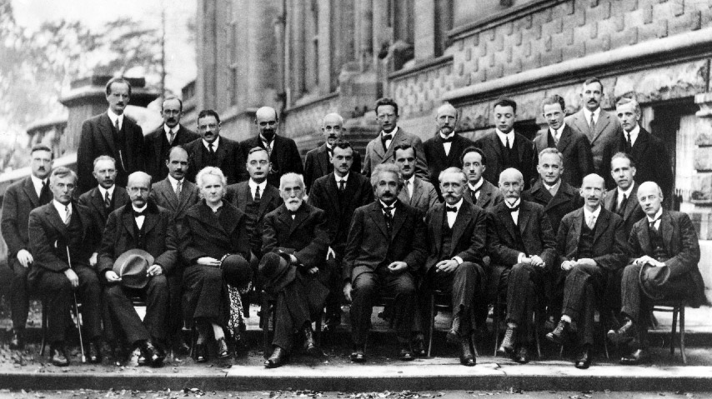
Title connecting the visuals below
Title goes here for the chart, graphic, or video you insert below. The chart, graphic, or video supports your thesis or claim sentence.
Title goes here for the chart, graphic, or video you insert below. The chart, graphic, or video supports your thesis or claim sentence.

Slide 8

ADD YOUR FINDINGS HERE
Explain what has been learned from this historical event and how that impacts or connects to you.

Slide 9

Influence & Conclusion
Explain to your audience the influence this historical event had on the world
Restate your thesis or claim sentence.

Slide 10
Customize this Template
Template Editing Instructions and Feedback

Slide 11

CREDIT CARD FRAUD DETECTION
Toshani Rungta (PES2UG19CS433) – CSE Dept.
Vismaya iyer (PES2UG19ec163) – ECE Dept.

Slide 12
Problem addressed and reason for choosing
MENTIONED PROJECT CHOSEN BECAUSE
An interest in machine learning along with the guidance and mentorship available to understand some core concepts of data analysis and the meaning of various training methodologies as well as their uses in different scenarios
PROBLEM ADDRESSED
The project will be able to classify fraud transactions from the various credit card transactions.

Slide 13

Methodology
Steps we followed/will perform during the course of the project
Choose the data set
Perform EDA using pandas
Perform Data Visualization using seaborn
Train the model using KNN
Test the model
CURRENT STATUS

Slide 14
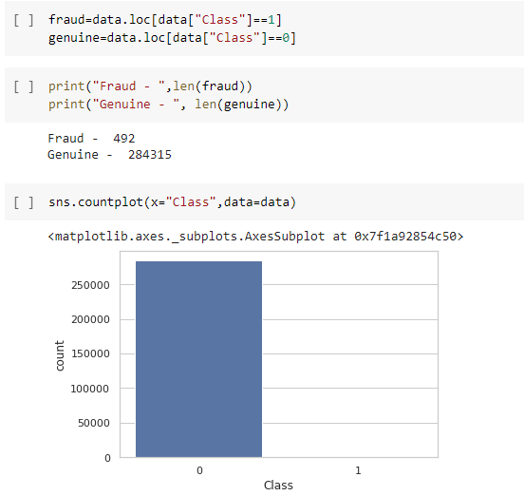
Where we left …
Checking for data imbalance
Since Class is the parameter that is going to be classified, hence, we check the statistics of the same.
We find that the data is highly imbalanced, with Genuine transactions being 99.83% and Fraud transactions being 0.17% .
The high imbalance observed results in a complex model being formed and causes overfitting of data which reduces precision.

Slide 15
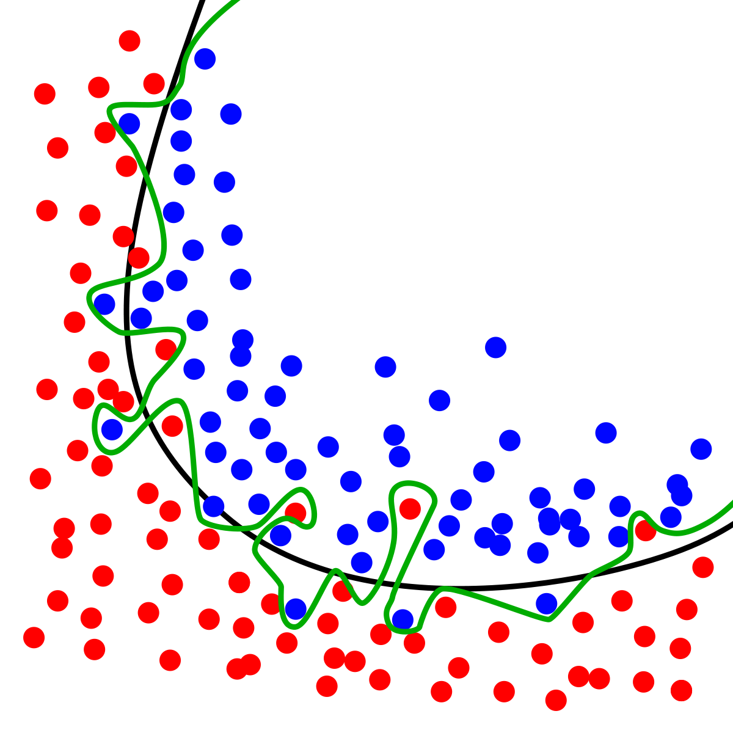
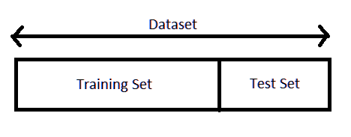
overfitting
Overfitting refers to a model that models the training data too well and doesn’t generalize well from our training data to unseen data/test data.
Overfitting can be detected by splitting the given dataset into train-test sets. If the accuracy of the model on the training set is much better than that on the test set, the model is over fitted.

Slide 16
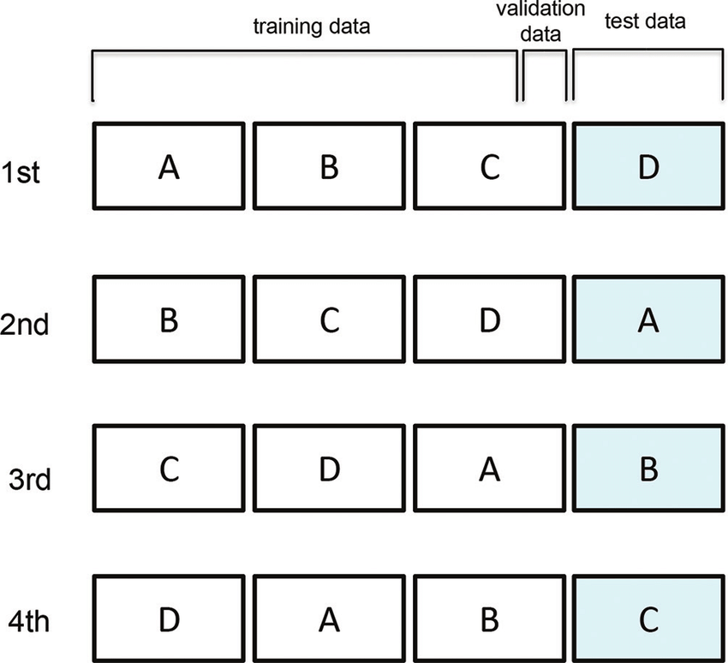
Cross validation
Cross-validation is a powerful preventative measure against overfitting. The initial data is split into k-folds, where the kth fold is used as the final test set while the remaining are divide into mini train-test sets that are used to tune the model.

Slide 17
Solving data imbalance and implementing knn

Slide 18
smote

Slide 19
THANK YOU!

